Slide 1
Active Dashboards
File created on: 1/15/2021 11:15:37 AM

Slide 2
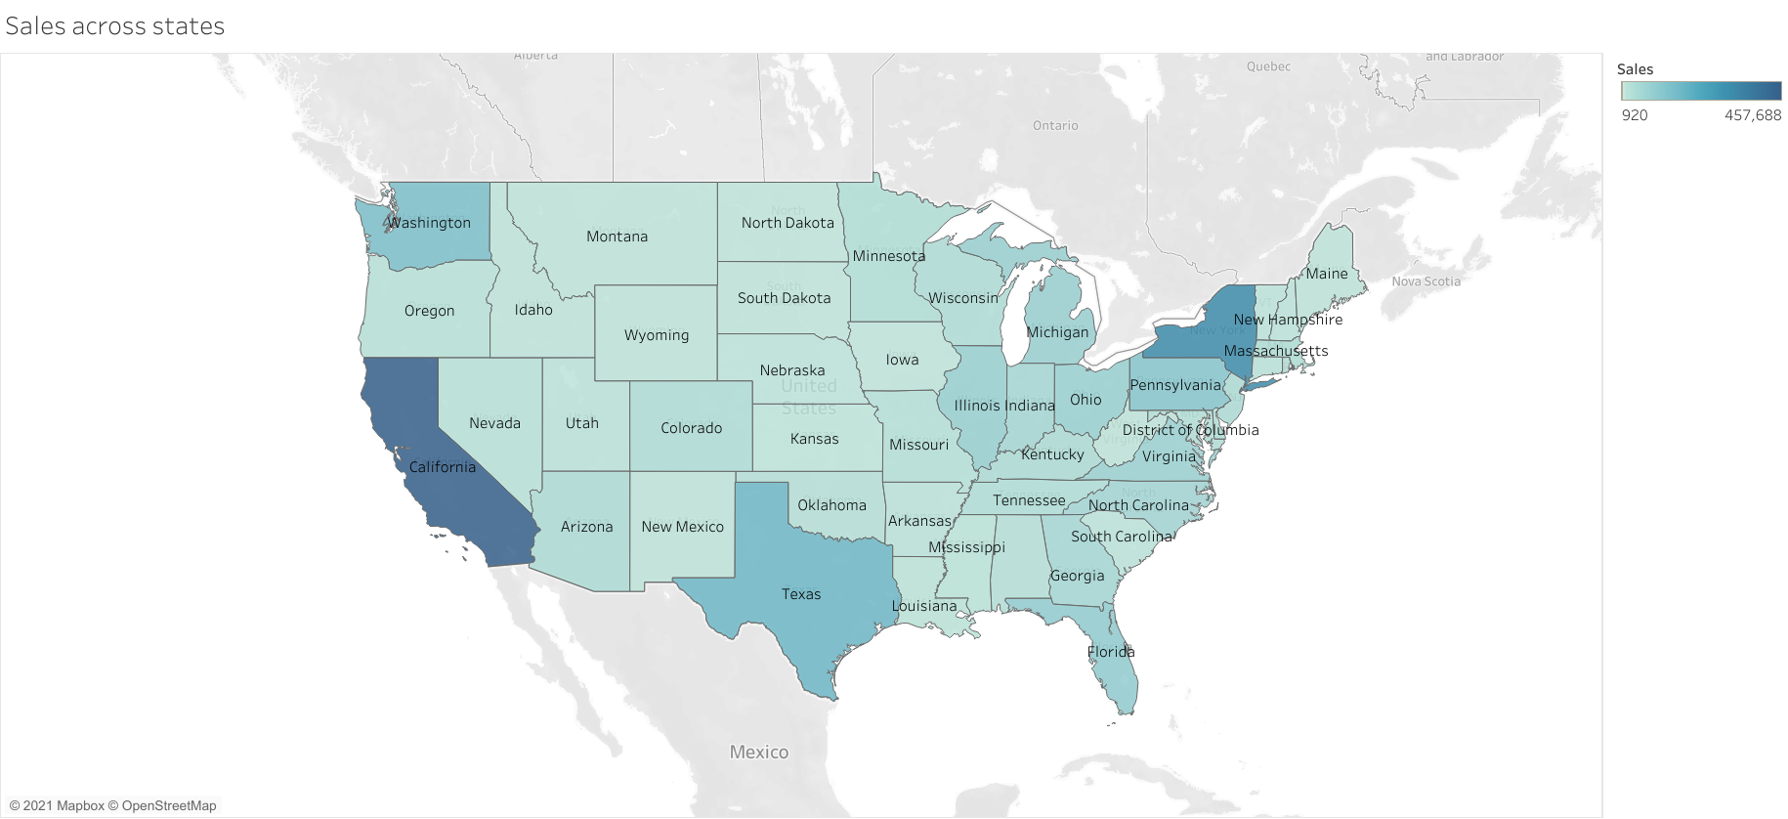

Slide 3


Slide 4
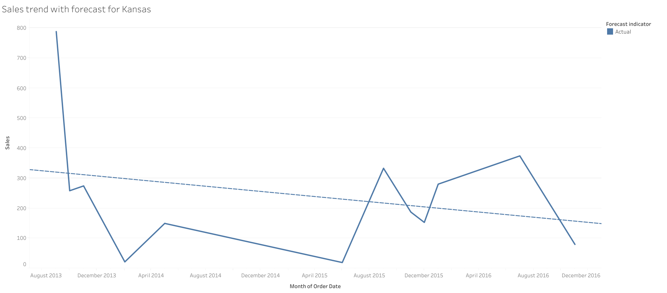

Slide 5
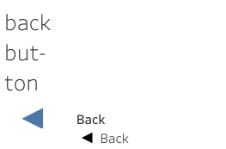

Slide 6


Slide 7
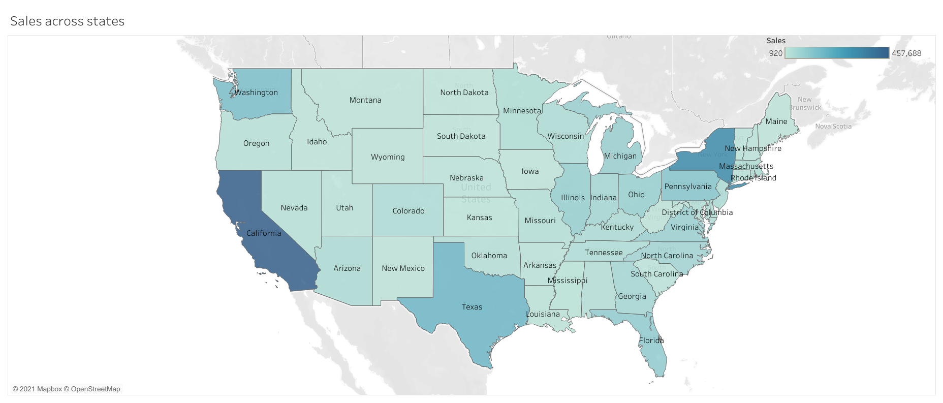

Slide 8
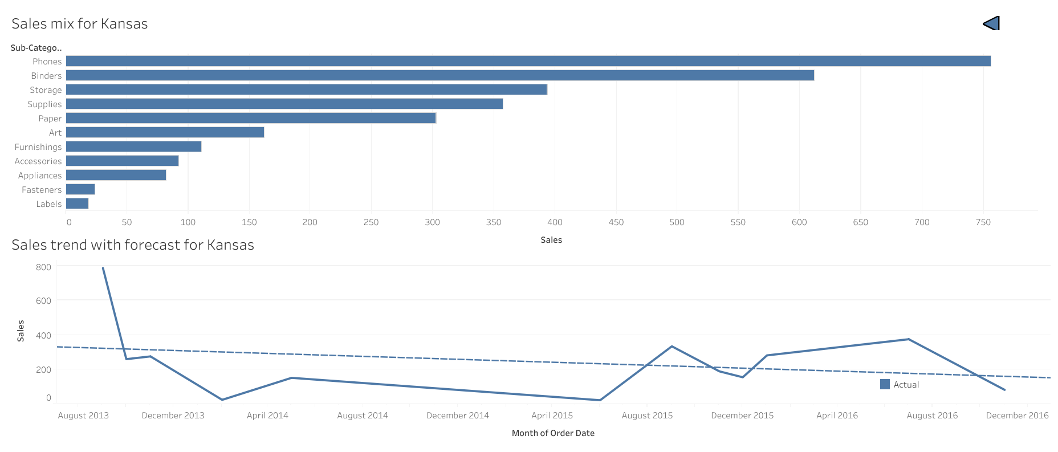

Slide 9
